Slide 1
Hospital DBMS
Luke Baal, Mackenzie Clarkson, Steven Trumble

Slide 2
Requirements
Must contain views that are easily interpreted by secretaries/triage
Must maintain relationships between rooms and patients, so that patients can be found if they are in a room.
DBMS must update concurrently i.e maintain version integrity for all users.
Must be able to hold tens of thousands of records
Provide various external APIs via url ID in the form of JSON.
Must be able to easily insert and query for data at any time
User friendly front end that provides useful views without requiring user to know SQL

Slide 3


Technology
MySQL
Used by Google, Facebook, Adobe
Equip to Query very large data sets
Node.js
Non-Threading, Non-Blocking
Server-side Javascript
Works well with JSON

Slide 4


Technology
PUG
Clean Syntax
Fast Development
Materialize
Google Material Design concept
Modern Design Layout

Slide 5
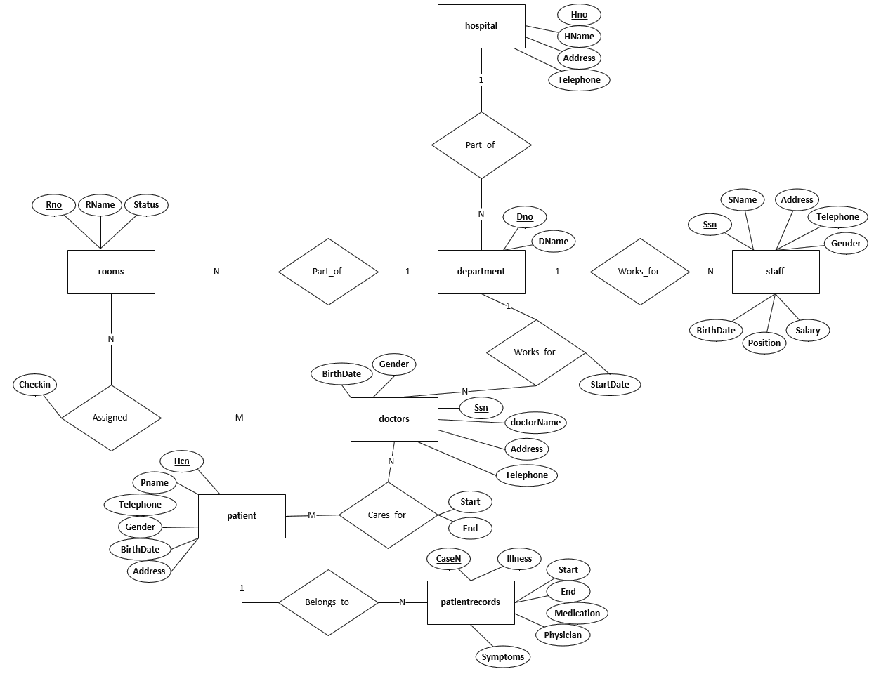
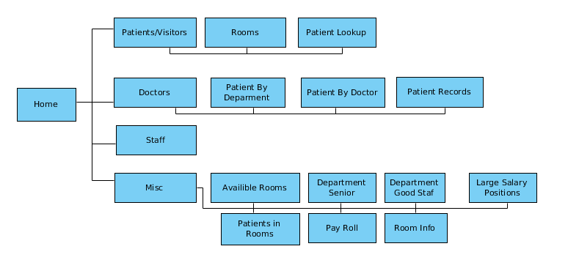
Architecture
ER Diagram
Web Page Layout

Slide 6
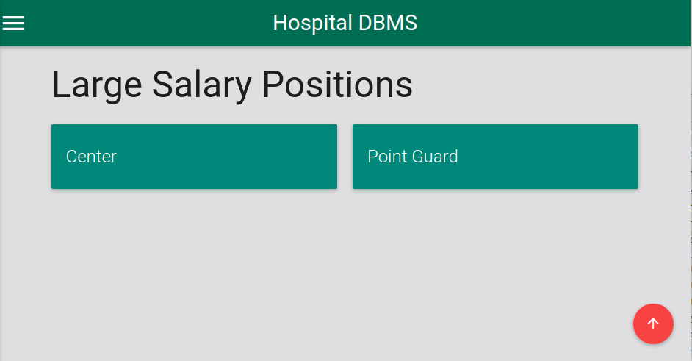
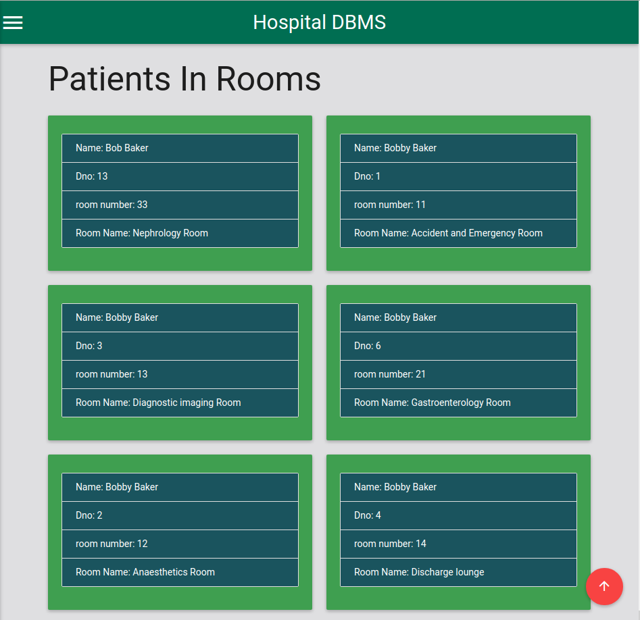
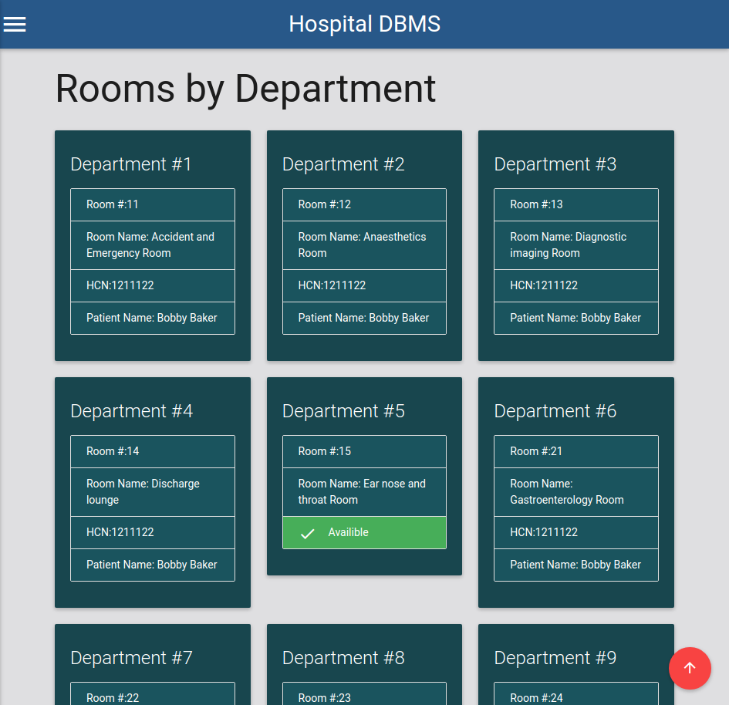
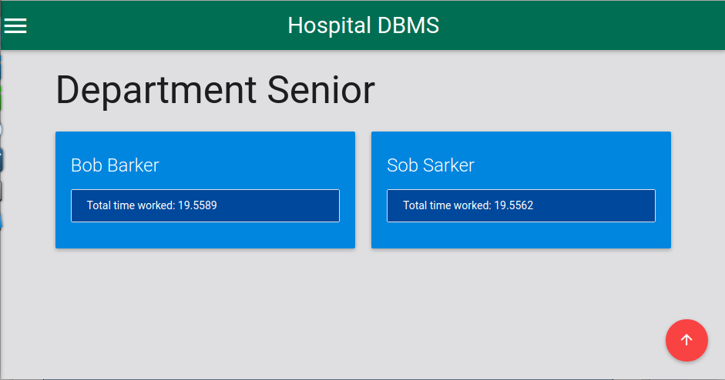
Views

Slide 7
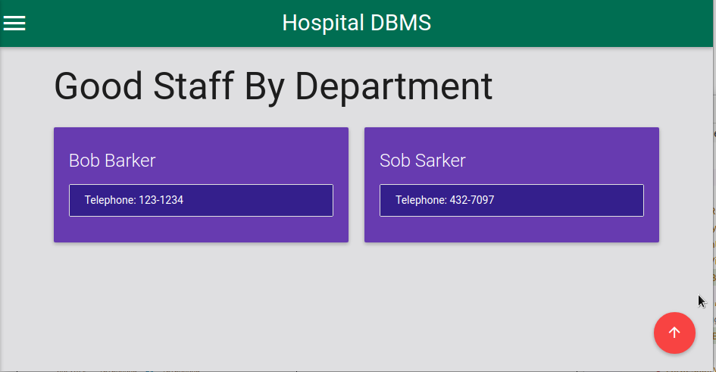
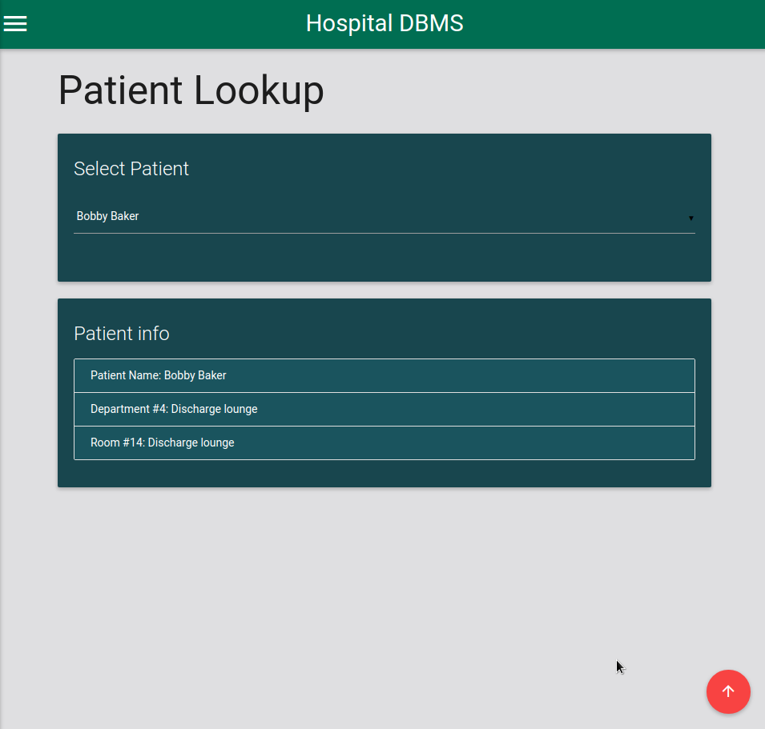
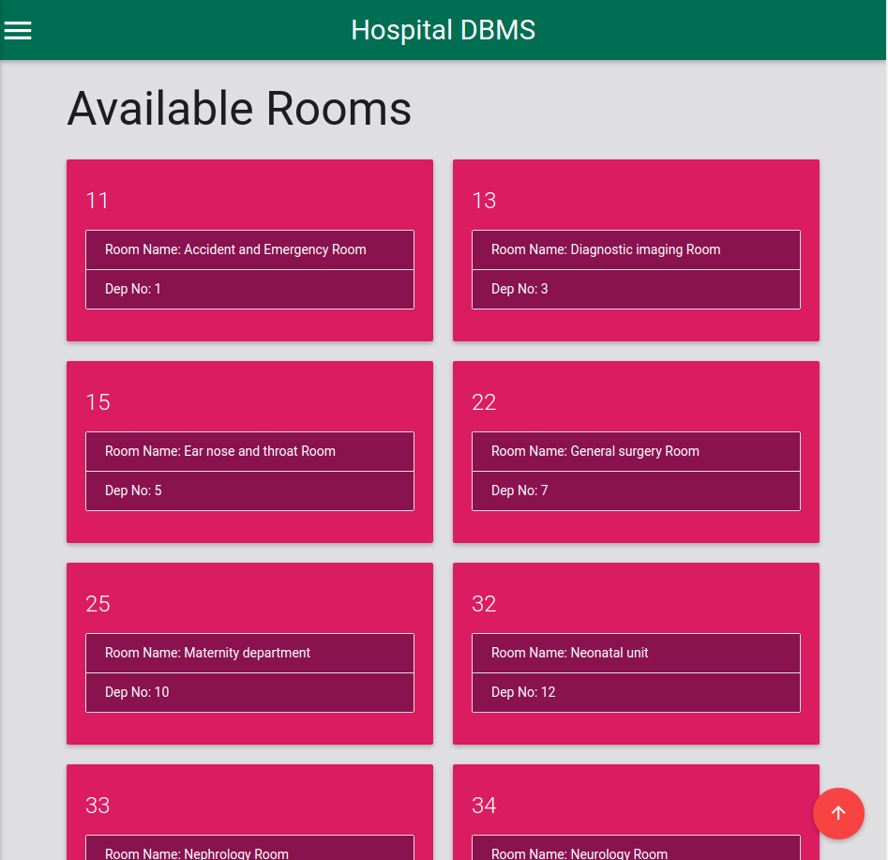
Views

Slide 8
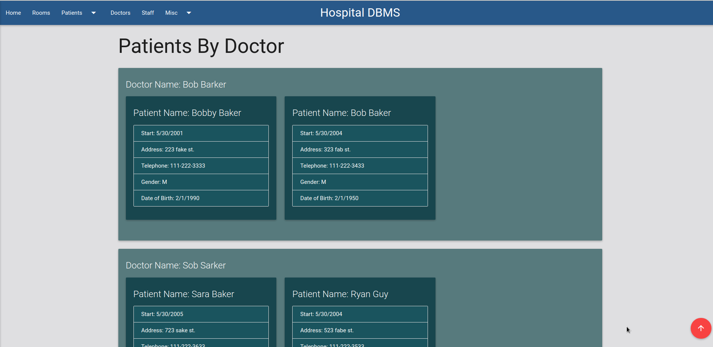
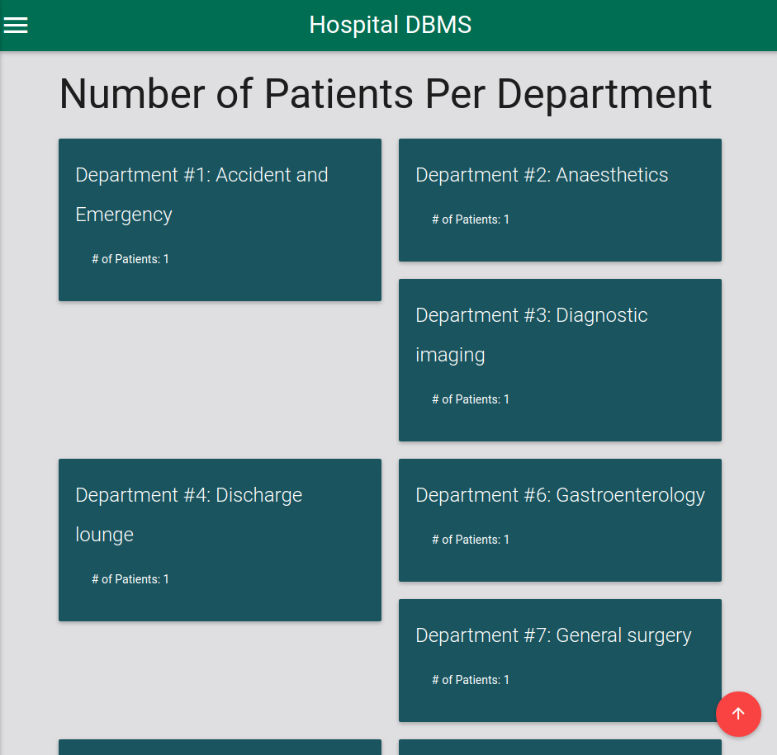
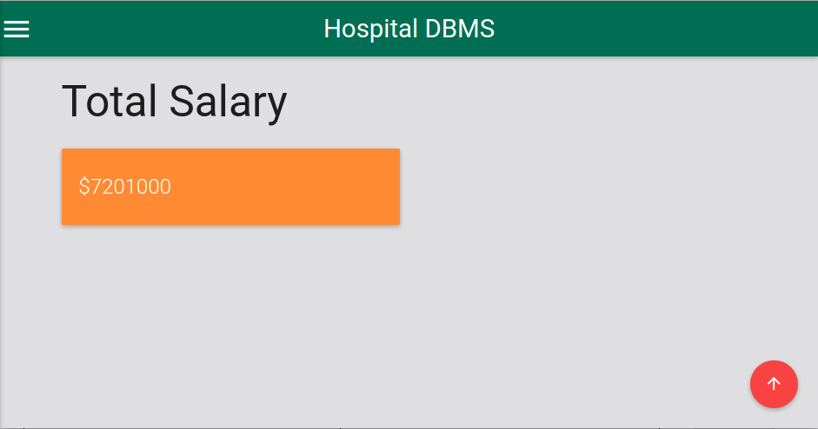
Views

Slide 9
Demo

